Slide 1
INFO2000 Elaboration Phase State Machine Diagrams
Susan Benvenuti
Thursday, 28 April 2016

Slide 2
A quick recap…
Use-Cases – descriptions and diagrams
System Sequence Diagrams
Activity Diagram
All the above are “behavioral” or “functional” diagrams as they show what the system will be doing
Domain Class Diagram
Structural diagram – models “things” used and produced by proposed system

Slide 3
This week …
State Machine Diagrams
Modelling how events change the state of objects in the system
Behavioral diagram – shows results of events affecting things
Textbook pages 122 – 133 (6th edit) or 114 -122 (7th edit)

Slide 4

Objects (Things …)
VEHICLE
registration
:
make
:
model
:
year
:
colour
:
licenced:
Domain concept: Vehicle
Visualisation of domain concept, i.e. a CLASS
Source: Mitchell Hughes

Slide 5
Classes and Objects
A class is essentially a template for all objects of a certain type, e.g. VEHICLE
An object is a specific instance of a class
VEHICLE
VEHICLE
registration
:
registration
vs
:
JB
007
make
:
make
:
Aston Martin
model
:
model
:
DB
5
year
:
year
:
1963
colour
:
colour
:
Grey
licenced:
licenced: Yes
Class
Object
Source: Mitchell Hughes

Slide 6
Creating Objects
The creation of an object is called instantiation
Objects contain both…
… data (in the form of attributes), and…
… methods (functionality associated with the object) - also sometimes called behaviours
Messages are sent to objects to tell them to perform methods
Objects can also have state, which is determined by values stored in its attributes, e.g.
A vehicle is in the “Licenced” state if an attribute “licenced” is set to “Yes” (it might also be “No” or “Pending”)
Object state changes are shown in state machine diagrams

Slide 7
A quick recap…
Use-case descriptions and diagrams, (system) sequence diagrams and activity diagrams all show what the business operations entail – what happens…
Class Diagrams allow us to model the classes of objects used in business processes: what they are (attributes), how they are linked (relationships / associations) and what functionality they are involved in (methods)
Class Diagrams allow us to define the underlying structure of the system
During analysis we concentrate on the attributes and relationships – we leave methods to design

Slide 8
Resolving *..* relationships: an example
Dashed
line
Note:
We can also
now introduce new
attributes specific to the new class
Association class created with appropriate label

Slide 9
State Machine Diagrams
Modelling how problem domain objects might change status over time in response to events, conditions or time.
Behavioral diagram – shows results of events affecting things
Creates a useful check and balance to ensure that we have identified all the possible states of any one object AND what causes an object to switch from one state to another
Sometimes referred to as Behavior State Machines (structured modelling)

Slide 10
State Machine Diagrams
For example, a CustomerOrder object might have an attribute called OrderStatus that allows us to track where in the business process a current order might be.
The customer might have “placed the order”, “confirmed the order”, “paid for the order”, the order might be “finalized”, “packed”, “awaiting delivery”, or “completed” (these are all states or state values).
CustomerOrder
Cust_No
Order_No
Order_Status :
Paid
Placed
Confirmed

Slide 11
State Machine Diagrams
So depending on where we are in the order process a particular CustomerOrder object might have an OrderStatus value of any of the above
If a customer phones in to check the status of their order, we can use the unique order number or customer number to look at their order and advise them of where it currently is in the process.

Slide 12
State Machine Diagrams show:
All possible allowed states
Possible first or start state(s)
Possible final states
Transitions (change) from one state to another (all possible reasons/routes)
The events or conditions that cause the change in state
The State Machine Diagram creates a link between a Class Diagram and the Use-cases.

Slide 13
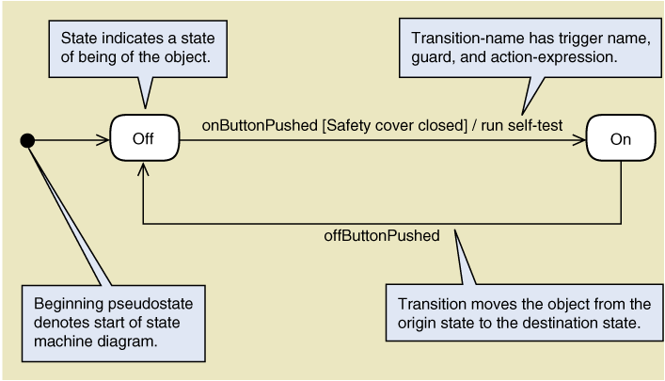
State Machine Diagram Syntax

Slide 14
States
State: (of an object) is a condition that occurs at some point in its lifetime when
it satisfies a particular condition or criterion,
or as a result of some event,
or is waiting for an event
States are labeled using a simple condition such as on, off, expired, etc. or by a verb phrase e.g. on order, awaiting shipment.
States are semi-permanent – something will happen to change the object from one state to another.

Slide 15
Transitions
Transition: shows the change of state of an object from one state to another as a result of an event, lapse of time or change in conditions.
Transition label:
transition name (parameters)[guard condition]/action event
Path: sequential set of connected states and transitions
Concurrent states: when an object may be in two or more states at the same time
Composite state: a state containing a path

Slide 16
State Machine Diagram Syntax

Slide 17
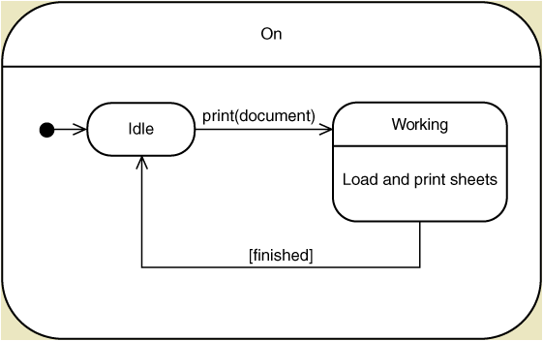
Syntax – Composite State

Slide 18
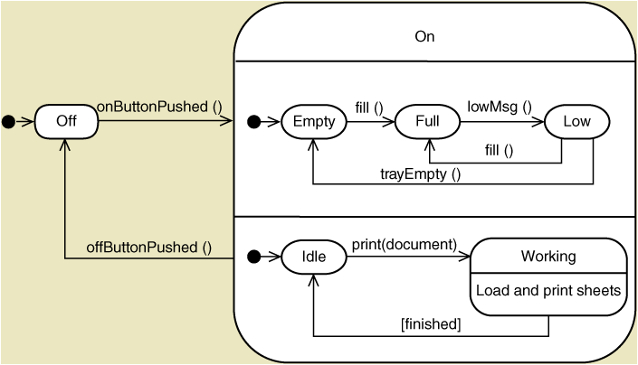
Syntax – Concurrent States/Paths

Slide 19
Some pitfalls to avoid
Every diagram must have a start and end state – sometimes the start and end state are the same thing (these are called pseudo states)
Every state must have a transition into and out of that state (sometimes these are connections to either the start or end pseudo states)
A transition may be circular – from a state back to itself (a loop) – but there must still be others into and out of that state
This helps us to ensure that we have catered for all possible states and the rules/conditions/events that move an object from one state value to the next

